Slide 1




Rotation Roadmap: Driving Your Students to Success
Nicole Culhane, PharmD- NDMU
Mark Freebery, PharmD- UMES
Toyin Tofade, PharmD- UMB

Slide 2
Objectives
Identify unique practices at your site to create valuable rotation activities and experiences.
Discuss how to evaluate your student’s performance and effectively provide constructive feedback.
Determine how to utilize rotation students more efficiently to extend your pharmacy practice.

Slide 3
Developing Rotation Activities
Toyin Tofade and Mark Brueckl
University of Maryland School of Pharmacy

Slide 4
Objectives
Identify the workflow and activities for the practitioner
Discuss how to present a road map for the specified rotation
Utilize practices at your site to create valuable experiences
List sample projects for the student to work on based on the rotation type

Slide 5
Why is this important?
This helps set expectations for the rotation experience
It helps provide a smooth transition from day to day
Allows the student to clarify preconceived notions
Prevents surprises later in the rotation
Provides a road map of what the overall experience ought to be

Slide 6
Setting Expectations
Keep in mind that you have been doing this for much longer than the student has
You may need to repeat or clarify instructions
They are new to your environment
The student knows much less than you do about patient care or your sites practice
Slow it down for them

Slide 7
Developing Rotation Activities
Identify Daily Activities in Pharmacy
  Patient Counseling
  Patient Education
  Rounding
  Staffing
  Drug monitoring
  ADE reporting
  Dispensing
  Additional Services

Slide 8
Developing Rotation Activities
Projects
  Case/Topic Discussion/Journal Scan
  Develop Patient-Focused Programs
  New Drug Update
Additional Activities

Slide 9
Patient Counseling
Prescription vs. OTC
  Set a goal to be achieved by the student
  Assign a specific time for patient counseling
  Place student in OTC aisle assisting patients
MTM
  Step by step process
  See one, do one, teach one

Slide 10
Patient Education
Device Training
  Blood Glucose Monitors
  Inhalers
Smoking Cessation
Otic/Ophthalmic Medications

Slide 11
Rounding
Looking up the data
Listening to the presentation
Listening to the discussion by health care providers
Listening to the patient
Providing a recommendation
Writing a note in the chart
Reviewing lab data and interpreting them
Looking up answers to follow up questions

Slide 12
Drug monitoring
Pharmacokinetics
TPN
Narrow therapeutic drugs
Sedation
Pain drugs
others

Slide 13
Additional Services
Immunizations
Blood Pressure Readings
Refill Reminders
Group Home/Assisted Living/LTC Outreach
Durable Medical Equipment
Compounding

Slide 14
Projects
Case/Topic Discussion/Journal Scan
  Student prepares patient case - presents to pharmacy staff
    Include relevant articles
    Provide treatment/drug therapy recommendations
  Working on medication use evaluation projects
  Develop Patient-Focused Programs
  Immunization Awareness
  Disease Screenings

Slide 15
Additional Activities
Counseling Tips
  Resource library for pharmacist use
Marketing
  Student to develop marketing materials for pharmacy programs
Adverse Drug Reaction Reporting
Business/Management Discussion
Drug Information Questions
  Student to respond to patient and/or practitioner questions

Slide 16
Additional Activities (cont’d)
Healthcare Discussion
  Pharmacy’s role in global health
Pharmacy Law Review
Community Presentations
  Student to give presentation to community group
  Pharmacy/Health-Related topic
Workflow Evaluation
  Student reviews for efficiency, safety, etc.

Slide 17
Additional Services
  Once a month meetings with key committees
    P & T
    Medication Safety
    Mortality and morbidity conferences
    Grand rounds

Slide 18
Lets Create Your Rotation

Slide 19
Things to consider
What are the activities you participate in every day?
What other activities do other colleagues participate in that will be beneficial to the student?
What background information is needed to be able to perform those duties flawlessly?
Any reading materials to help provide better context for each of those activities?
Review the school’s syllabus and see which course will best suit your site.

Slide 20
Assemble a Calendar
What will the student do mostly everyday
What activities will need to be spread out
Spread out the reading discussions to about 2-3 times a week
Is there a project or projects that will benefit the site and student?
How long will it take to collect data and complete that work?

Slide 21
Evaluating Student Performance and Providing Constructive Feedback
Mark Freebery and William Harbester
University of Maryland Eastern Shore School of Pharmacy

Slide 22
Objectives
Discuss the difference between formative and summative evaluations.
List the types of feedback and identify which one or combination is necessary for your students.
Identify the methods of providing feedback.
Discuss how providing constructive feedback can promote student success.

Slide 23
Set Rotation Expectations
Discuss with student at the beginning of the rotation
How will you be assessing their work/improvement
  Set goals and project expectations
  Be familiar with the school’s evaluation tools
How and when will feedback will be given

Slide 24
Feedback vs. Evaluation
 | Feedback | Evaluation
Timing | Immediate/ Timely | Scheduled
Setting | Informal/ on-the-fly | Formal/ Private
Content | Formative | Summative
Scope | Specific Actions | Collective Performance
Purpose | Improvement (skills/knowledge) | “Grading” and Improvement

Slide 25
Types of Feedback
Positive
  Not provided enough
  Involves pairing desired behavior with positive reinforcement
  Motivates individual for additional achievement
Negative (or not so positive)
  Obtains less predictable results
  May stop behavior or outcome that has already occurred, but:
    Student may perform better
    Stop trying because feel they are being scrutinized

Slide 26
Types of Feedback
Constructive
  Helps individuals understand their learning needs
  Balanced; contains positives and areas for improvement
  Most desired, but most difficult
No Feedback (Withholding)
  Worst; most common
  Students dislike most
  Least motivating response
  Leaves individuals “blindsided”

Slide 27

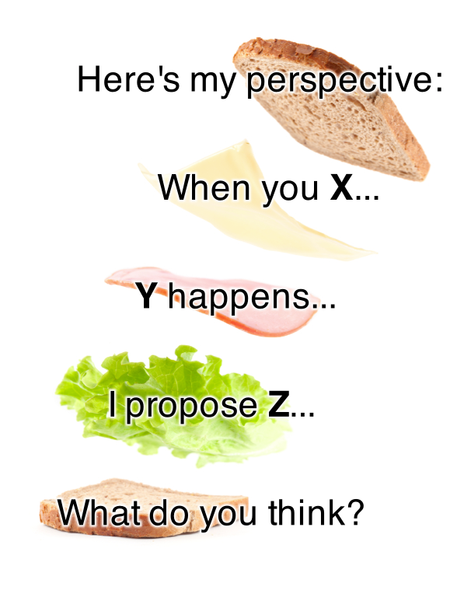
Feedback Methods
Sandwich Method

Slide 28
Feedback Methods
W3 Method
What Went Well?
  “You communicate clearly and in a manner that patients can understand, well done.”
What Didn’t Go Well?
  “However, I noticed that the information you recorded in the chart was very extensive.”
What Could We Do Differently Next Time?
  “Be sure to document what is relevant and pertinent to developing a treatment plan, and omit details that are not patient related.”

Slide 29
Providing Effective Feedback
Inform students at start of the learning experience to expect feedback routinely
Conversation should take place in a relaxed, private area
Engage in a two-way conversation with student
Be descriptive, not evaluative (i.e. what did you observe about the student’s performance that requires feedback)
Focus on behavior that can be changed, not personal traits of the individual
Observe an activity more than once before offering feedback.

Slide 30
Providing Effective Feedback
Well-timed (offer feedback as soon as event has taken place)
Get input from other preceptors/colleagues
Limit feedback to one or two items
Tied to specific goals
  Related to goals and objectives for the experience
  Ask student to offer own thoughts and plans for improvement
Clear, specific and related to the facts

Slide 31
Why Provide Feedback
Improving self awareness
Enhancing self esteem
Raising morale
Encouraging people to want to learn
Offering reassurance
Motivation
Improving individual performance

Slide 32
Final Thought
“Feedback matters. It really matters. Good feedback is like a road map, a site map, an energy drink, a bungee jump, or meditative moment for your brain. It makes you smarter, more focused, more confident, and more capable of doing your best work.”
-Jill Geisler Poynter Institute

Slide 33
Utilizing Students to Extend Your Pharmacy Practice
Nicole Culhane
Notre Dame of Maryland University School of Pharmacy

Slide 34
Objectives
List ways for balancing patient care and precepting responsibilities
Discuss strategies for integrating students into the workplace
Develop a potential plan for integrating students into your daily pharmacy practice

Slide 35
Integrating students into your pharmacy practice
Identify points in the workflow that the student can easily step into
Provide readings or prior student experiences for student to easily learn about your practice followed by a short discussion

Slide 36
Integrating students into your pharmacy practice
Cross-train other pharmacists/technicians on staff to help teach the student
Discuss with the student regarding how they feel they can contribute to your practice based on past and present experiences
Discuss areas for student involvement
  Operational
  Managerial
  Direct patient care

Slide 37
Integrating students into your pharmacy practice
Identify areas where students can have autonomy and function as the pharmacist with proper oversight
Medication reconciliation
Rounding
Immunizations
Medication therapy management
Tell me and I'll forget; show me and I may
remember; involve me and I'll understand.
- Chinese Proverb

Slide 38
Integrating students into your pharmacy practice
Allow the day to day operations to establish the ‘curriculum’
Student pharmacists can help to improve your practice and be the impetus to expand an existing service or start a new service
  Medication safety
  Patient satisfaction
  Research/data collection

Slide 39
Encouraging student responsibility and autonomy
Setting the foundation/groundwork early – orientation
Discussing student expectations and assigning areas where students are fully accountable
Making sure they understand their level of responsibility and accountability

Slide 40
Encouraging student responsibility and autonomy
Establish a culture of follow-up; they are the ‘go to’ people with certain issues about patients
Set weekly goals
Give students a list of questions for every patient and report back to you
Determine a point at which the student ‘meets competency’ and can be autonomous
Continue to add on additional competencies weekly

Slide 41
Encouraging student responsibility and autonomy
Presentations to staff, medical residents, nurses
Assigning students reading and presentations on literature you have not had time to read
Assigning specific tasks that occur commonly that become the students' responsibility
Focus on particular medication conditions (diabetes, COPD, heart failure, antibiotics)

Slide 42
Incorporating Students Into Your Workflow: Health-System
In-patient Rounds
  Assign students their ‘own’ patients that they are responsible for
    Gathering patient data
    Medication history
    Laboratory data
  Pre-rounding with the students to assure adequate preparation to answer specific questions/issues that arise
  Hide in the background or go to nursing station so students feel they are responsible
  Encourage students to spend as much time on the unit as possible so they are available when questions arise

Slide 43
Incorporating Students Into Your Workflow: Health-System
Rounds (con’t)
  Pair students with patients covered by medical students if possible
    Encourage peer mentorship in areas of expertise
    Utilize a hierarchy of teaching (IPPE/APPE)
  Don’t be too quick to jump in and ‘save’ the student on rounds
  Decide on number and complexity of patients based on student

Slide 44
Incorporating Students Into Your Workflow:
Health-System
Pharmacy to dose protocols
Formulary Interchange
IV to PO switches
Renal dosing
Vancomycin dosing

Slide 45
Incorporating Students Into Your Workflow: Community
Doctor calls
Insurance calls/prior authorizations
Immunizations
OTC consults
Medication therapy management
Medication counseling
Patient education
Drug information questions

Slide 46
Conclusions
Student pharmacists CAN be integrated into busy patient care practices with some thought and prior planning
Invest in the time upfront and you WILL get a ROI in the long run
  Be flexible and take the time necessary to provide proper orientation
  Explain your practice and rotation expectations
Notes:
Planning is key – what are regular things you provide for your practice that students can be integrated into
inservice presentations
P&T
DUEs

